Slide 1
DIABETES PREDICTION USING MACHINE LEARNING

Slide 2
Abstract
-> Diabetes mellitus is the most common disease worldwide and keeps increasing everyday due to changing lifestyles, unhealthy food habits and over weight problems.
-> There were studies handled in predicting diabetes mellitus through physical and chemical tests, are available for diagnosing diabetes.
-> Data science methods have the potential to benefit other scientific fields by shedding new light on common questions.
-> In the proposed system, an efficient way of detecting diabetes is proposed through machine learning and deep leaning. Under machine learning, we used the classification algorithm Support Vector machine (SVM) and neural network (NN) for deep learning algorithm.
-> The experiment results shows that the prediction of diabetes done at high accuracy.

Slide 3
Introduction
Diabetes mellitus is a chronic, lifelong disease caused by excessively high blood sugar levels. Diabetes is a disease that aects the body's ability to produce the hormone insulin, thereby making carbohydrate metabolism abnormal and raising blood sugar levels. As reported by the World Health Organizaon in 2020 were 463 millions are with diabetes, 1.5 million deaths, as the report indicates that is not difficult to guess how much diabetes is very serious and chronic.
Many researchers conduct experiments to diagnose diseases using different machine learning approach classification algorithms such as K-Nearest Neighbor (KNN), Logistic Regression (LR), Decision Tree (DT), Support Vector Machine (SVM), Gradient Boosting (GB) and Random Forest (RF) because researchers have proven demonstrated that machine learning algorithms are more effiective.

Slide 4
What is diabetes?
Diabetes is a condition that happens when your blood sugar (glucose) is too high. It develops when your pancreas doesn’t make enough insulin or any at all, or when your body isn’t responding to the effects of insulin properly. Diabetes affects people of all ages. Most forms of diabetes are chronic (lifelong), and all forms are manageable with medications and/or lifestyle changes.
Glucose (sugar) mainly comes from carbohydrates in your food and drinks. It’s your body’s go-to source of energy. Your blood carries glucose to all your body’s cells to use for energy.
The technical name for diabetes is diabetes mellitus. Another condition shares the term “diabetes” — diabetes insipidus — but they’re distinct. They share the name “diabetes” because they both cause increased thirst and frequent urination. Diabetes insipidus is much rarer than diabetes mellitus.

Slide 5
Types Of Diabetes
There are several types of diabetes. The most common forms include:
Type 2 diabetes: With this type, your body doesn’t make enough insulin and/or your body’s cells don’t respond normally to the insulin (insulin resistance). It mainly affects adults, but children can have it as well.
Prediabetes: This type is the stage before Type 2 diabetes. Your blood glucose levels are higher than normal but not high enough to be officially diagnosed with Type 2 diabetes.
Type 1 diabetes: This type is an autoimmune disease in which your immune system attacks and destroys insulin-producing cells in your pancreas for unknown reasons. Up to 10% of people who have diabetes have Type 1.Gestational diabetes: This type develops in some people during pregnancy. However, if you have gestational diabetes, you’re at a higher risk of developing Type 2 diabetes later in life.

Slide 6
Symptoms Of Diabetes
Symptoms of diabetes include:
Increased thirst (polydipsia) and dry mouth.
Frequent urination.
Fatigue.
Blurred vision.
Unexplained weight loss.
Numbness or tingling in your hands or feet.
Slow-healing sores or cuts.
Frequent skin and/or vaginal yeast infections.

Slide 7
Causes Of Diabetes
Causes of diabetes include:
Insulin resistance: Type 2 diabetes mainly results from insulin resistance. Insulin resistance happens when cells in your muscles, fat and liver don’t respond as they should to insulin.
Autoimmune disease: Type 1 diabetes and LADA happen when your immune system attacks the insulin-producing cells in your pancreas.
Hormonal imbalances: During pregnancy, the placenta releases hormones that cause insulin resistance.
Pancreatic damage: Physical damage to your pancreas — from a condition, surgery or injury — can impact its ability to make insulin, resulting in Type 3c diabetes.
Genetic mutations: Certain genetic mutations can cause MODY and neonatal diabetes.

Slide 8
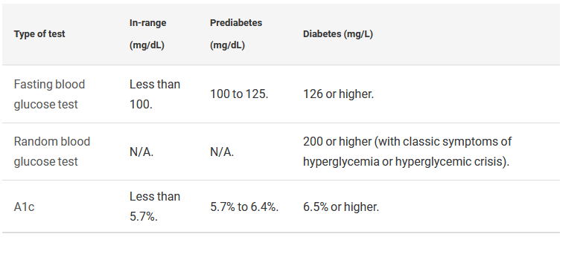
Types Of Test

Slide 9
Problem Statement
Doctors rely on common knowledge for treatment. When common knowledge is lacking, studies are summarized after some number of cases have been studied. But this process takes time, whereas if machine learning is used
-> the patterns can be identified earlier.
-> For using machine learning, a huge amount of data is required. There is very limited amount of data available depending on the disease. Also,
-> The number of samples having no diseases is very high compared to number of samples actually having the disease.

Slide 10
Existing Problem
-> Data mining approach like clustering, classification were studied in existing system.
-> Diabetes prediction using algorithms such as k- Nearest Neighbour (k-NN), k-means, branch and bound algorithm was proposed.
-> A basic diabetic dataset is chosen for carrying out the comparative analysis.
-> The importance of feature analysis for predicting diabetes by employing machine learning technique is discussed.

Slide 11
Proposed System
-> The proposed system study is classification of Indian PIMA dataset for diabetes as binary classification problem
-> This is proposed to achieve through machine learning and deep learning classification algorithm.
-> For machine learning, SVM algorithm is proposed
-> For deep learning, Neural network is used.
-> The proposed system improves accuracy of prediction through deep learning techniques.

Slide 12
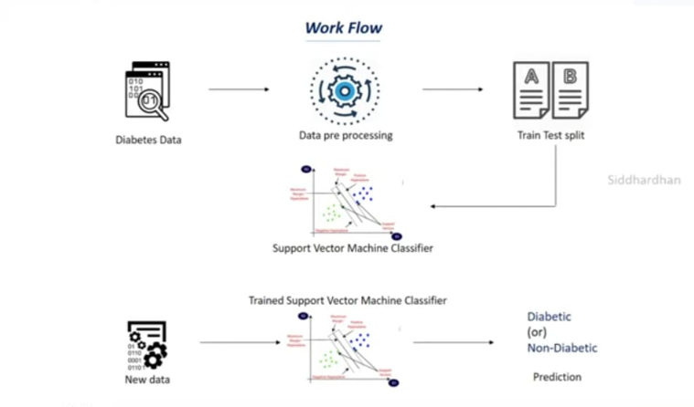
Our Project

Slide 13
Support Vector Machine
DEFINITION:
Support Vector Machine is a system for efficiently training linear learning machines in kernel-induced feature spaces, while respecting the insights of generalisation theory and exploiting optimisation theory.
• SVMs pick best separating hyperplane according to some criterion
– e.g. maximum margin
• Training process is an optimisation
• Training set is effectively reduced to a relatively small number of Support vectors
Feature Spaces
We may separate data by mapping to a higher-dimensional feature space
– The feature space may even have an infinite number of dimensions!
We need not explicitly construct the new feature space

Slide 14
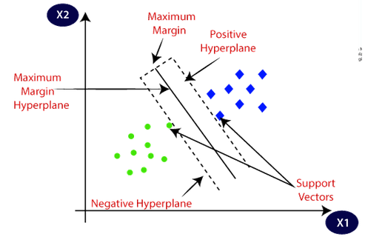
important terms

Slide 15
Now let’s define two main terms which will be repeated again and again in this article:
Support Vectors: These are the points that are closest to the hyperplane. A separating line will be defined with the help of these data points.
Margin: it is the distance between the hyperplane and the observations closest to the hyperplane (support vectors). In SVM large margin is considered a good margin. There are two types of margins hard margin and soft margin. I will talk more about these two in the later section.
Maximum margin hyperplane:The decision boundary provided by the SVMs can be referred to as the maximum margin hyperplane or the maximum margin classifier.
Positive hyperplane:Boundary line situated at positive region is known as Positive Hyperplane.
Negitive hyperplane:boundary line situated at negative region is known as Negative Hyperplane.

Slide 16
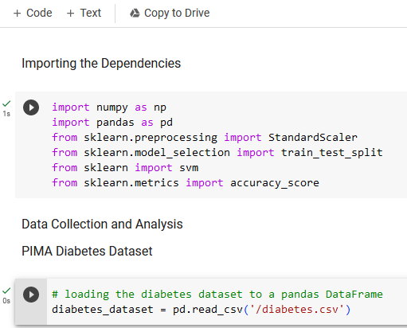
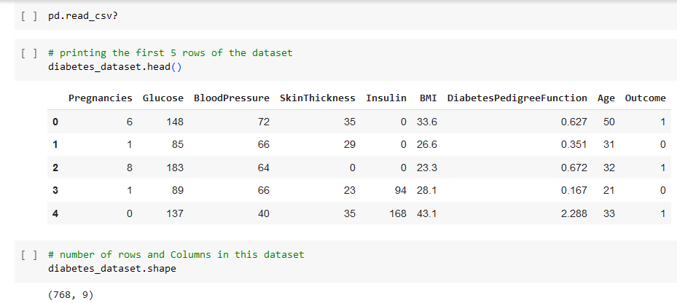
CODE

Slide 17
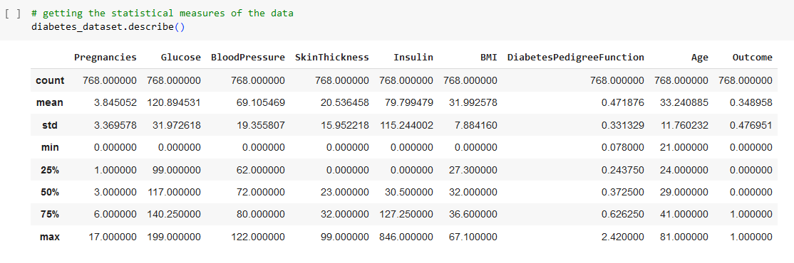
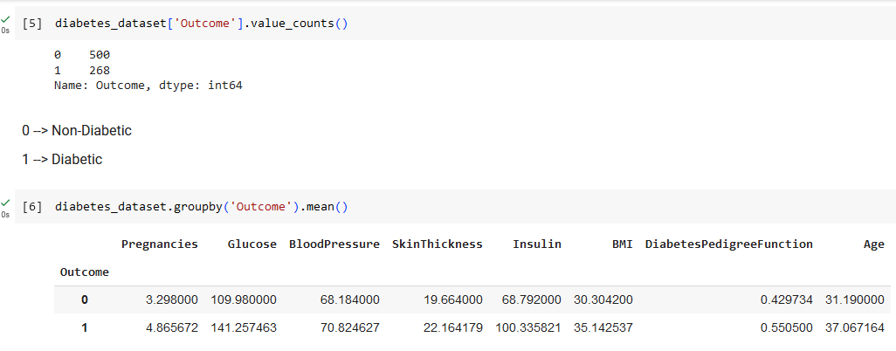

Slide 18
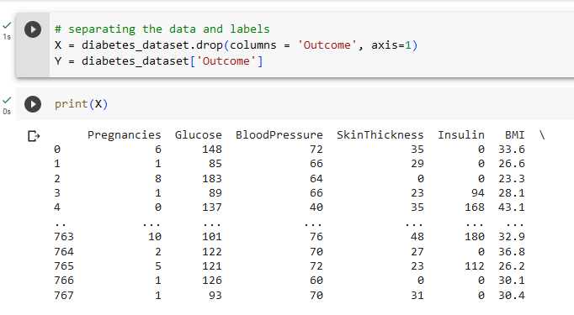
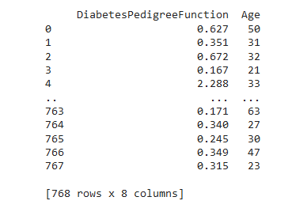

Slide 19
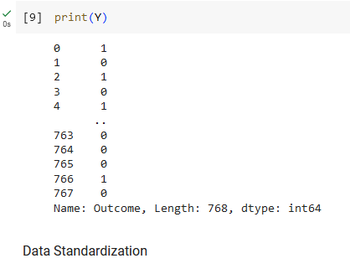
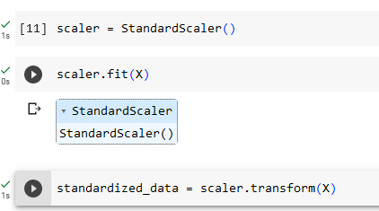

Slide 20
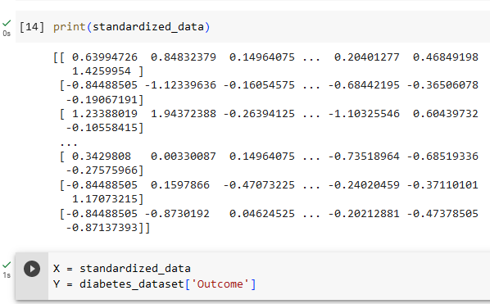
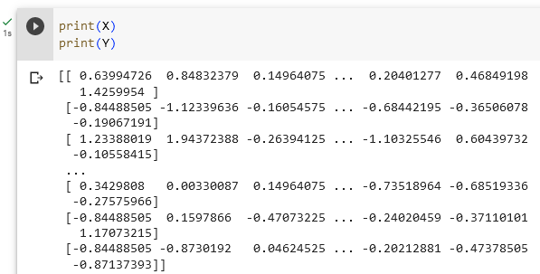

Slide 21
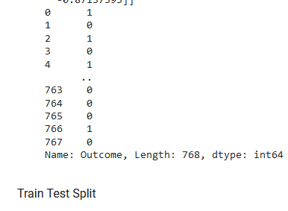
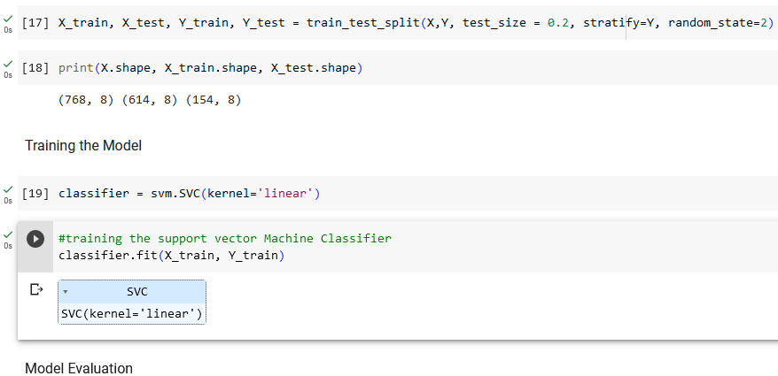

Slide 22
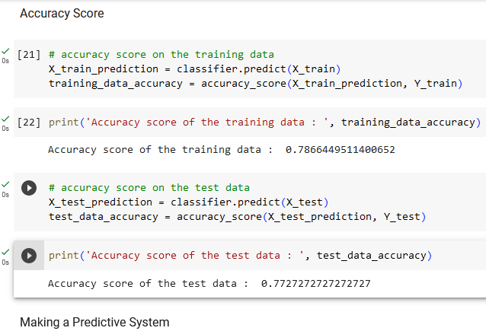
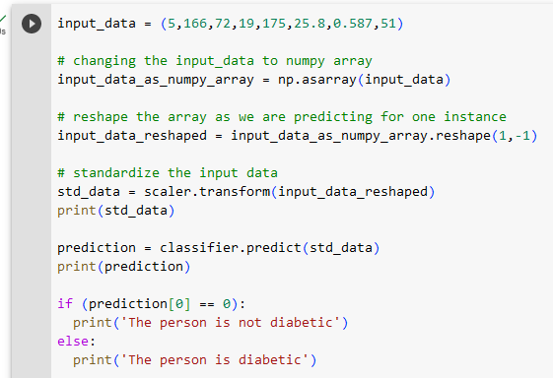

Slide 23
[[ 0.3429808 1.41167241 0.14964075 -0.09637905 0.82661621 -0.78595734 0.34768723 1.51108316]][1]
The person is diabetic
/usr/local/lib/python3.10/distpackages/sklearn/base.py:439: UserWarning: X does not have valid feature names, but StandardScaler was fitted with feature name warnings.warn(

Slide 24
CONCLUSION
CONCLUSION:
In conclusion, the diabetes prediction project utilizing machine learning techniques has proven to be successful and effective. The model achieved accurate predictions by analyzing relevant features and patterns in the dataset. This project demonstrates the potential of machine learning in aiding early detection and prevention of diabetes. Further research and development can enhance the model's performance and expand its applications in healthcare. Ultimately, this project contributes to improving patient outcomes and reducing the burden of diabetes on individuals and healthcare systems.

